Slide 1


Project 2
Darryl Bunn
Antonio Gomez
Robert Riggs
Jonathan Torres

Slide 2

What Categories see the most Sales?

Slide 3
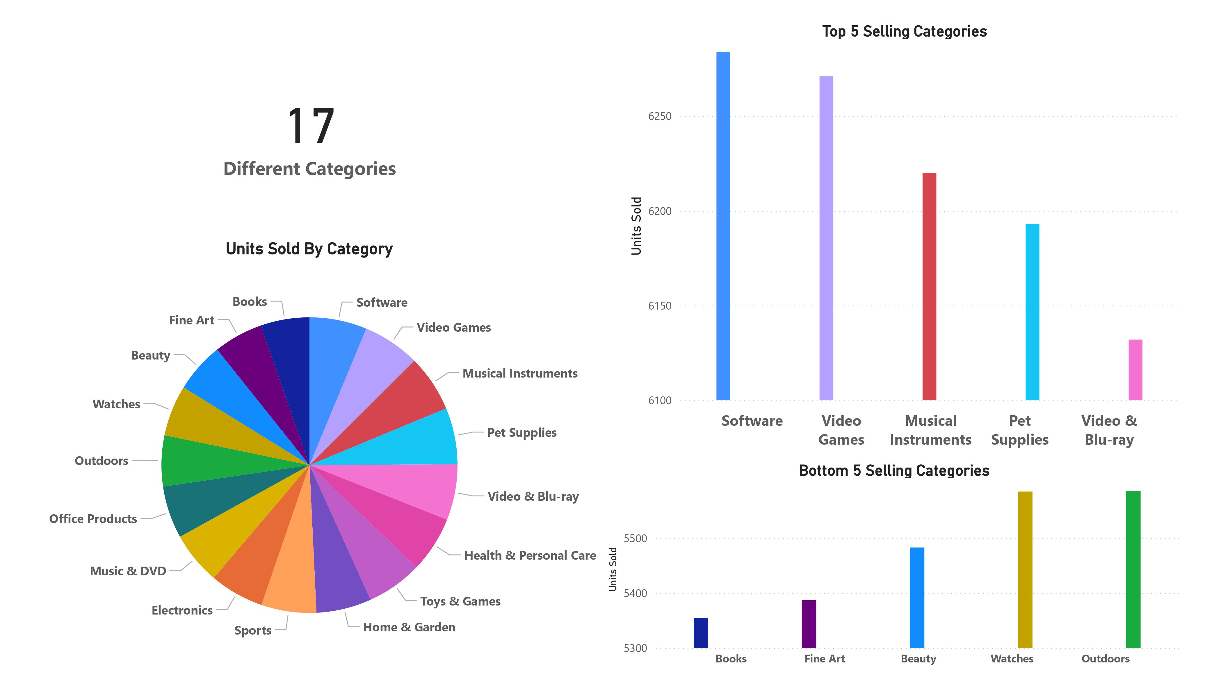

Slide 4
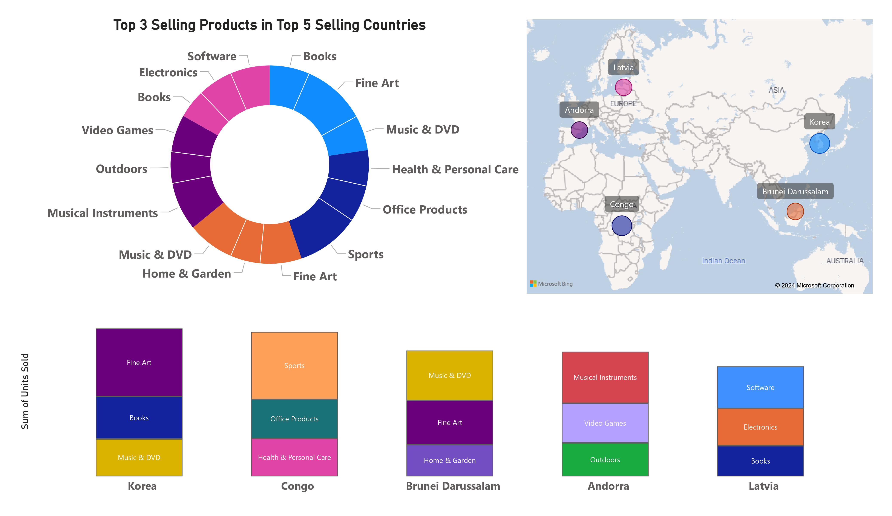

Slide 5
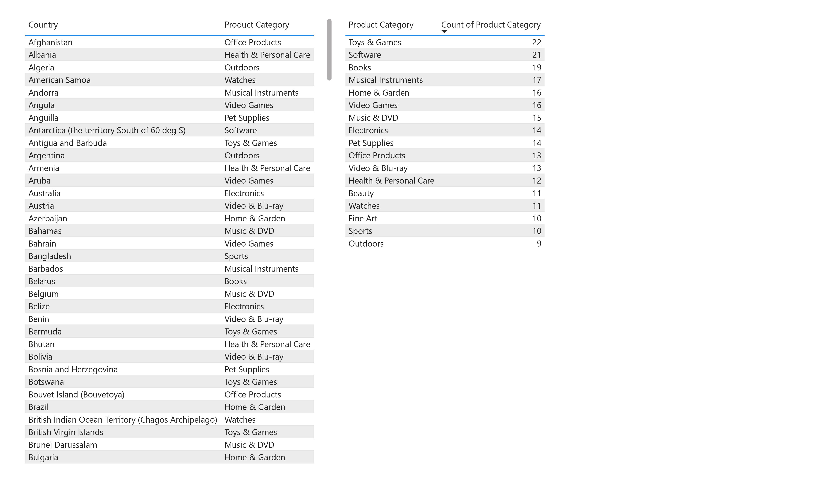

Slide 6

How does the popularity of products change throughout the year?

Slide 7
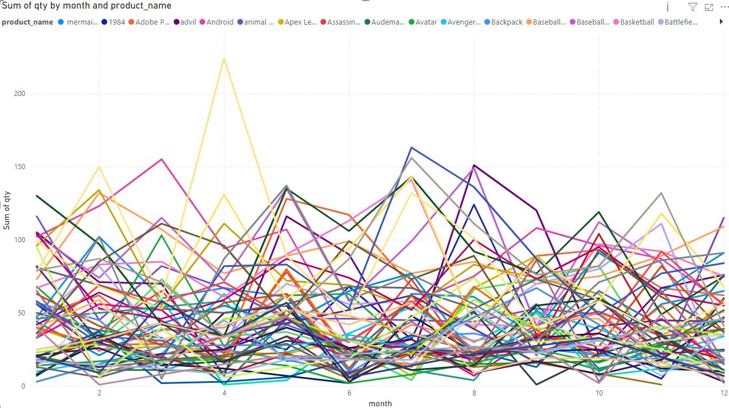
How does the popularity of products change throughout the year?

Slide 8
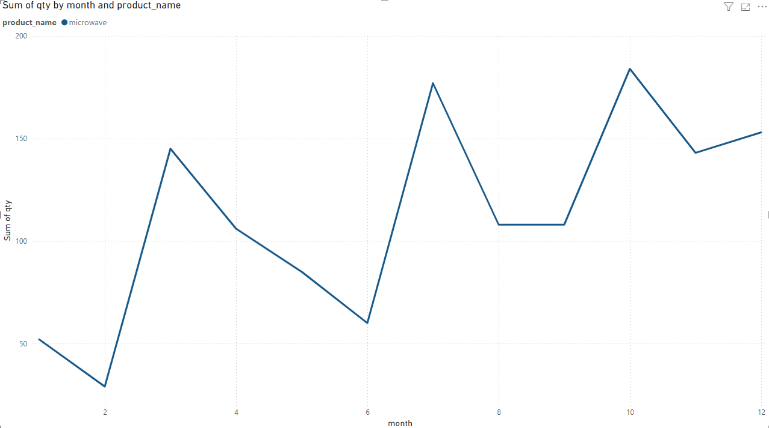
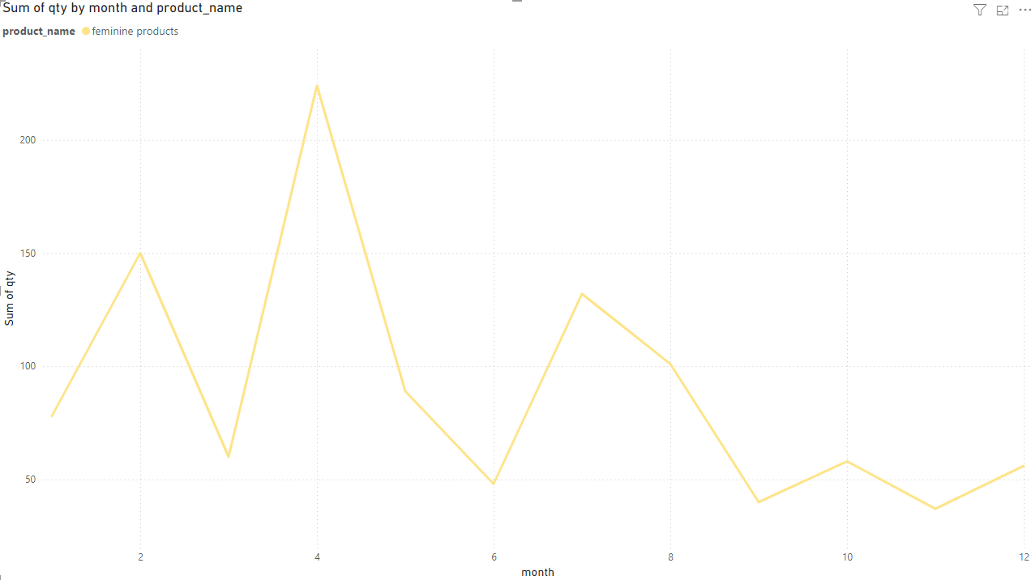
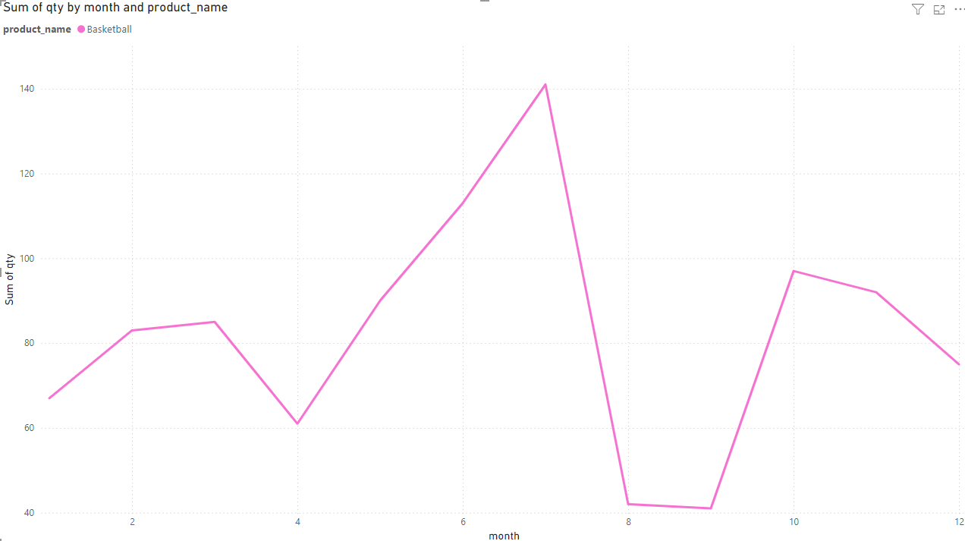
Examples of filtering by certain products

Slide 9
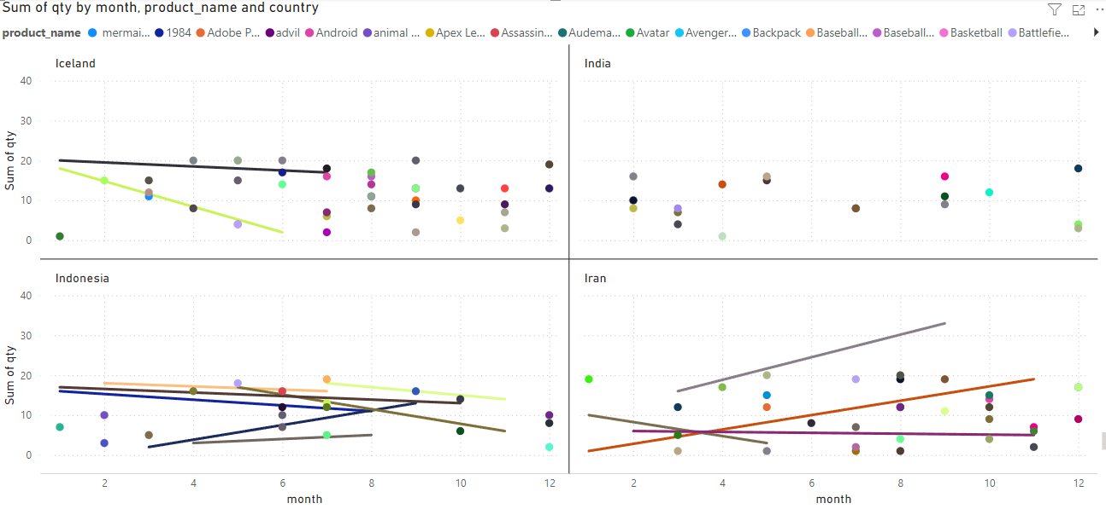
How does the popularity of products change throughout the year, per country?

Slide 10
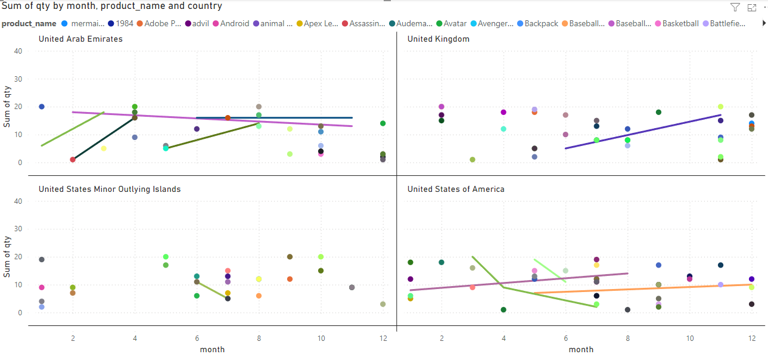

Slide 11
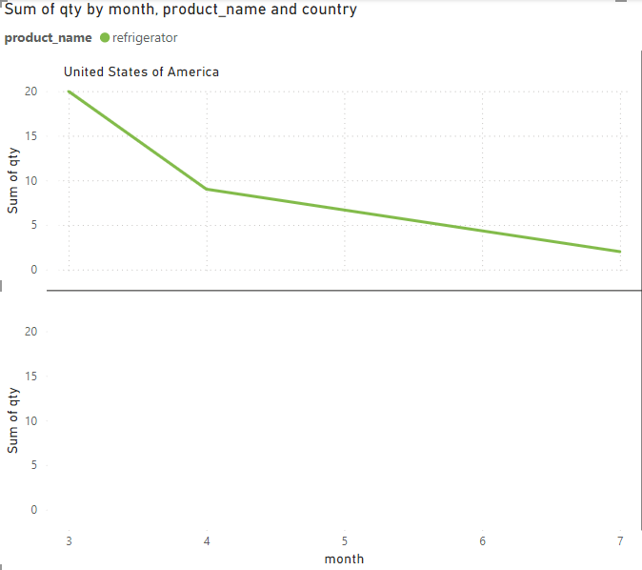
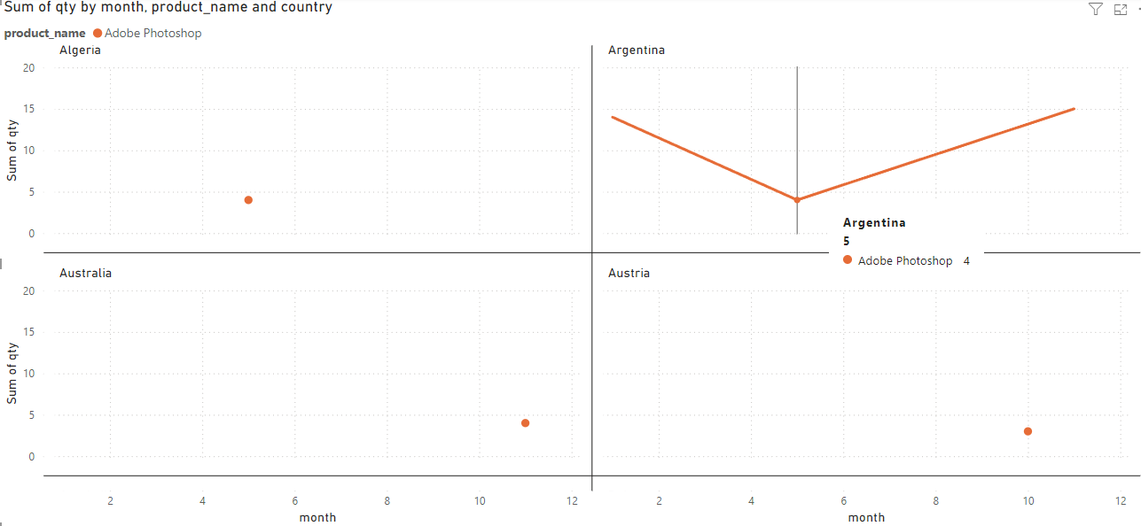
Example of filtering by a specific country and product
Example of filtering by a specific product

Slide 12

Which locations see the highest traffic of sales..

Slide 13
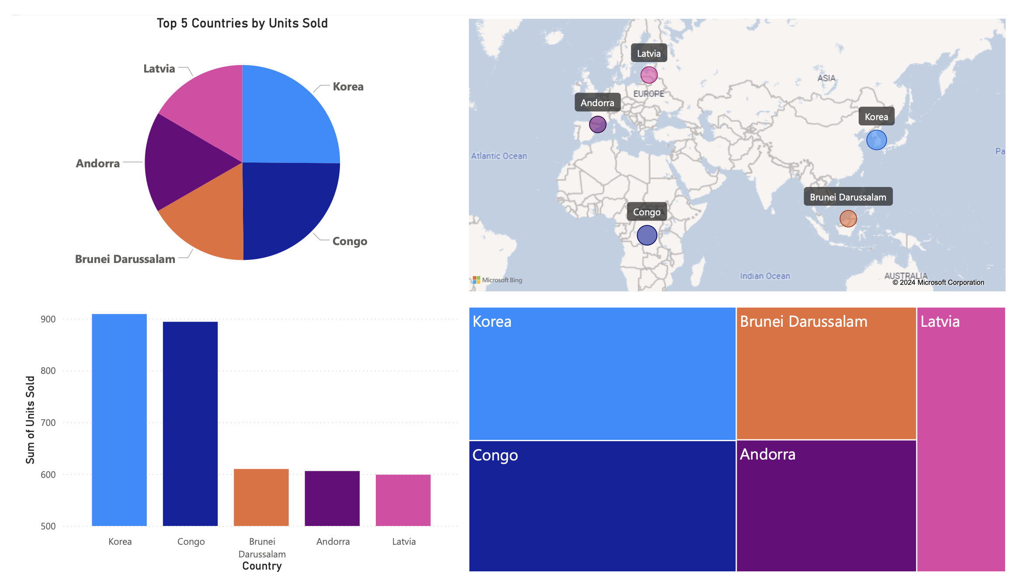

Slide 14
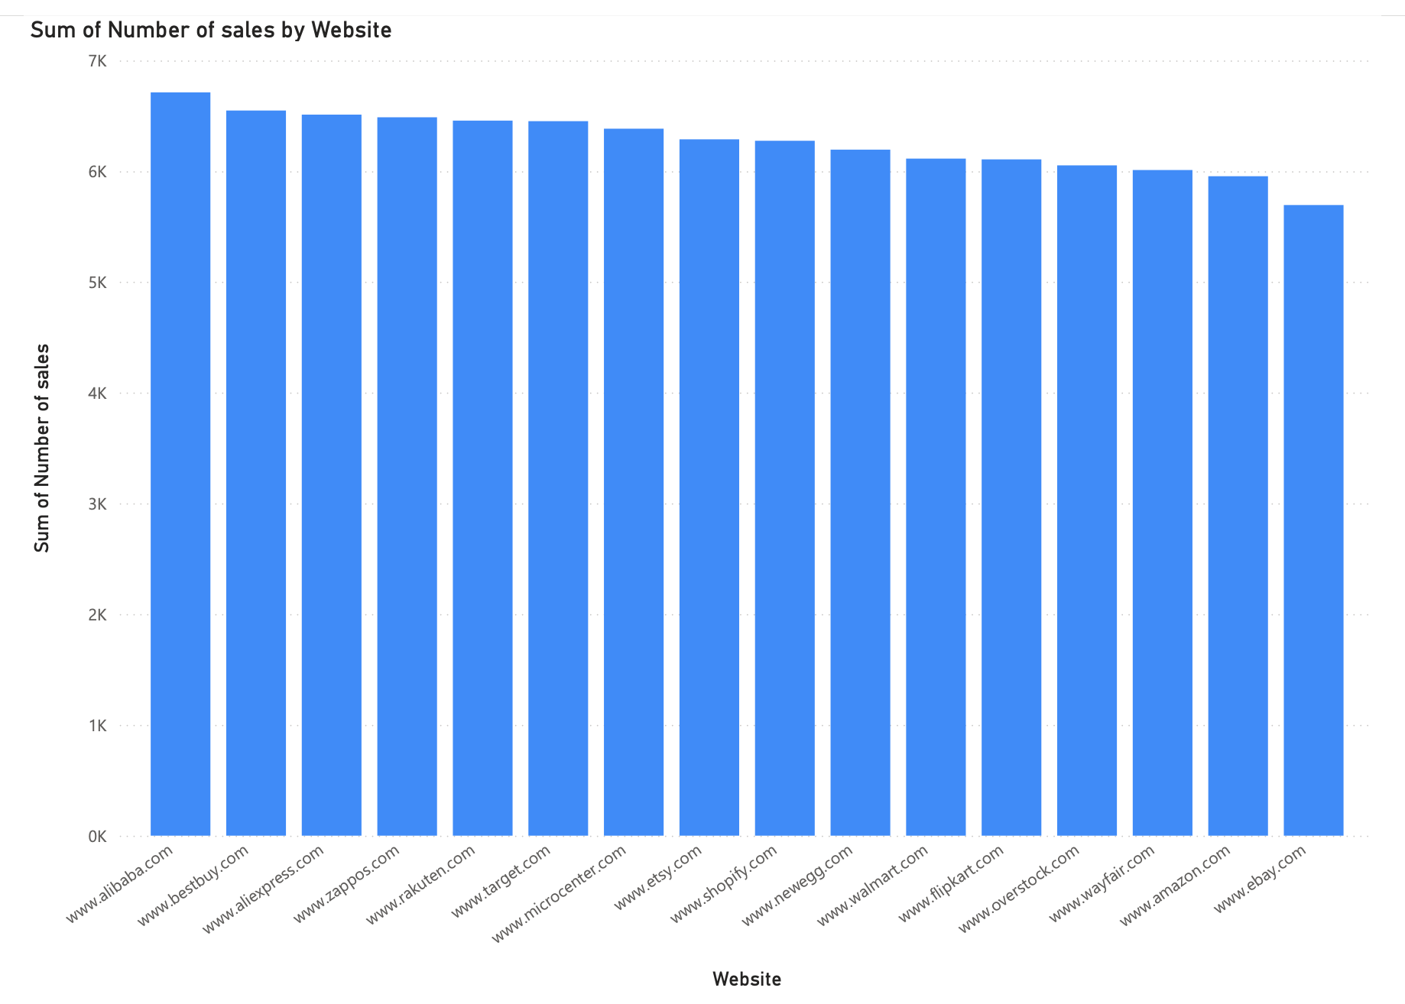
By website

Slide 15
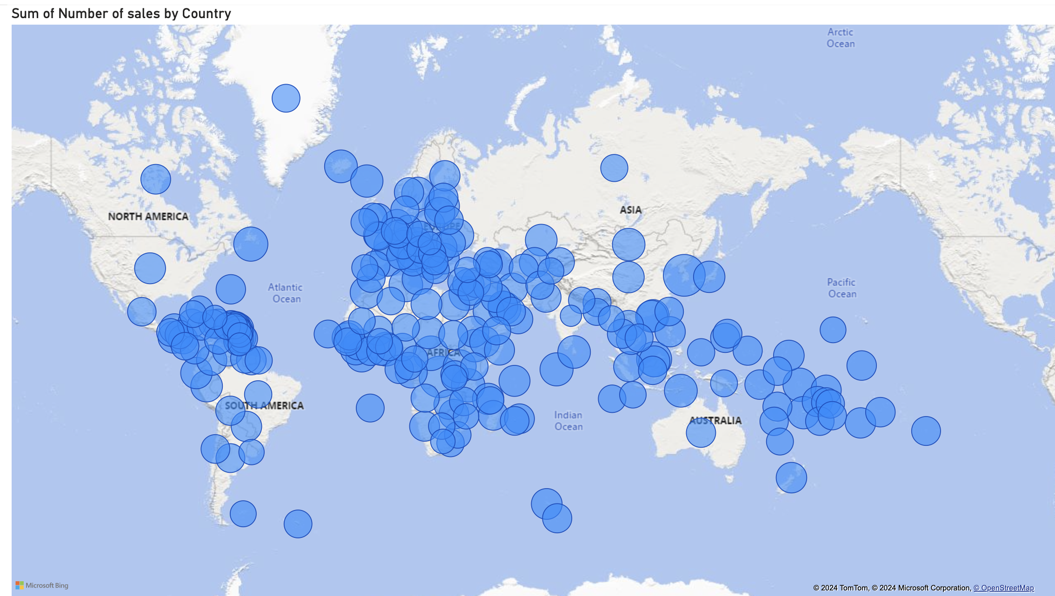
Number of sales by country

Slide 16
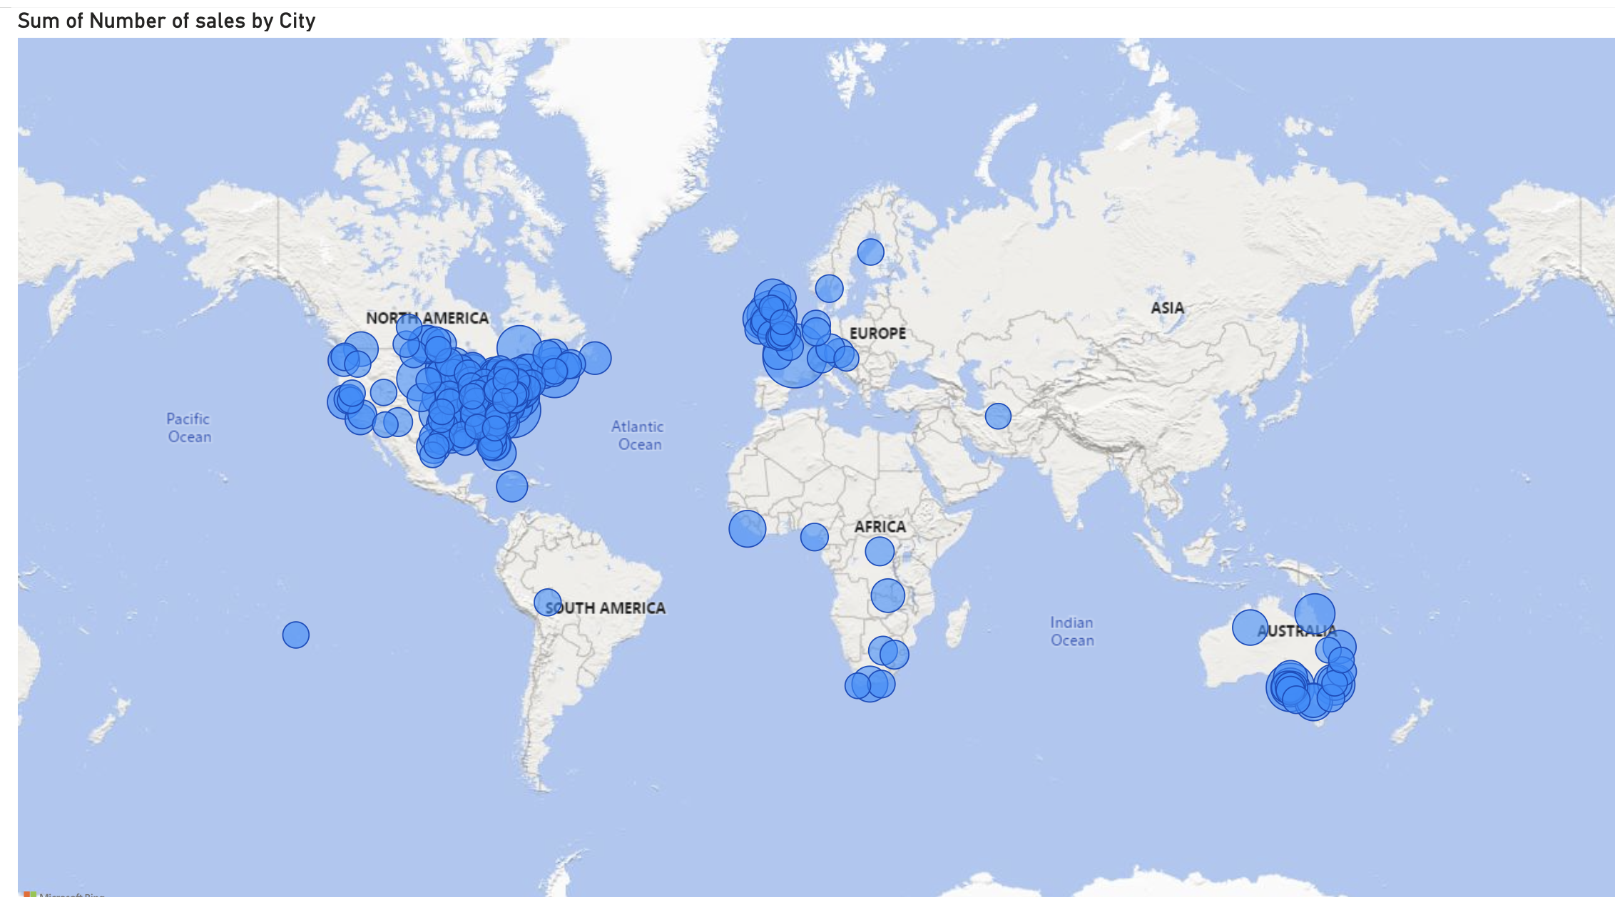
Number of sales by city

Slide 17
What times have the highest traffic of sales? Per country?

Slide 18
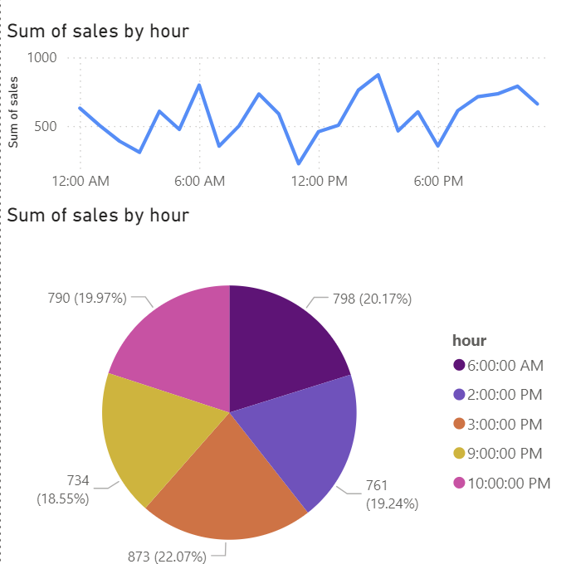
Peak Hours

Slide 19
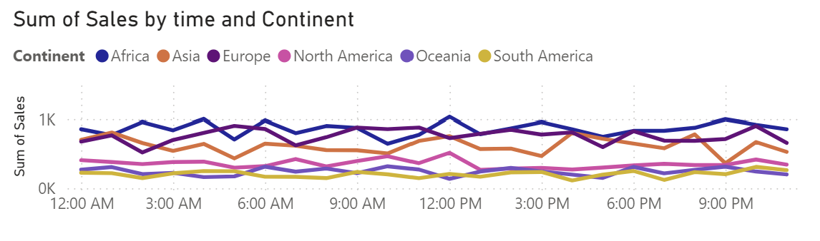
CONTINENT

Slide 20
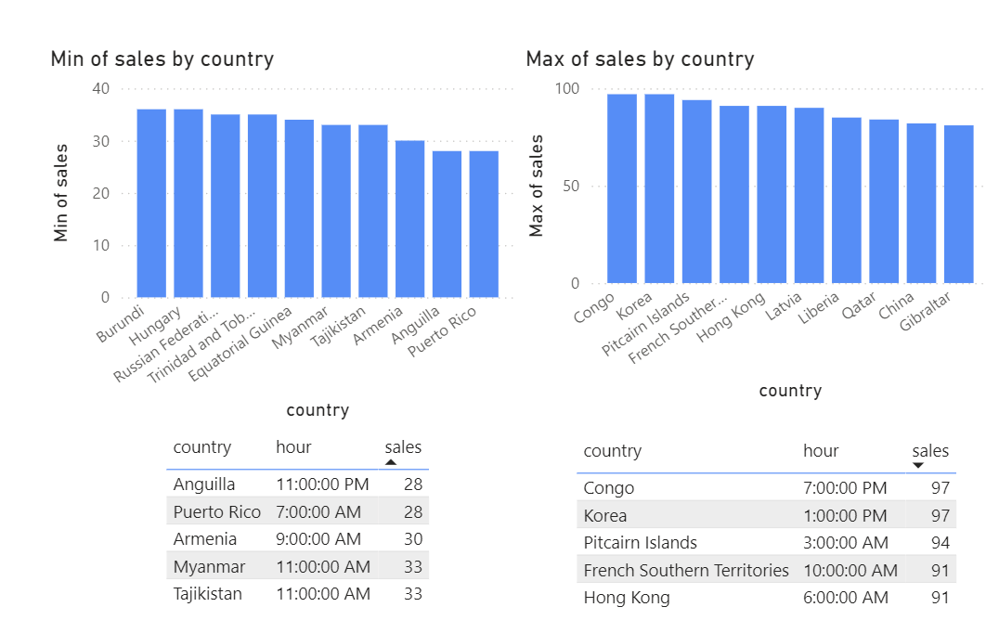
Top Countries
Bottom Countries

Slide 21

Observations
Since most of our sales occur in the middle/East countries, targeting those countries with marketing strategies can yield the greatest return based off geographical location.
While the most selling category of product is Software overall, the top selling category in most countries is Toys and Games. Perhaps with more advertising we can increase those revenue streams.
Different products sell better during varying months of the year due to their individual qualities. Focusing marketing on popular products during the months where their popularity is at its height may boost sales further.

Slide 22

QUESTIONS?

